Slide 1
Introduction to dbms and dbms architecture

Slide 2
A database is a collection of related data.
Data - known facts that can be recorded and that have implicit meaning.
A database has the following implicit properties:
■ A database represents some aspect of the real world, sometimes called the miniworld. Changes to the miniworld are reflected in the database.
■ A database is a logically coherent collection of data with some inherent meaning. A random assortment of data cannot correctly be referred to as a database.
■ A database is designed, built, and populated with data for a specific purpose. It has an intended group of users and some preconceived applications in which these users are interested.
Notes:
A database can be of any size and complexity.
A database may be generated and maintained manually or it may be computerized.

Slide 3
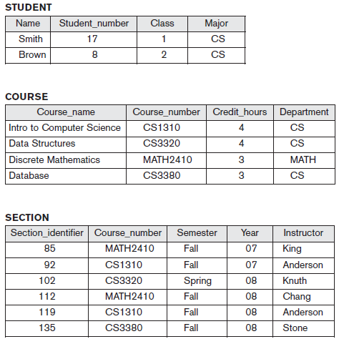

Slide 4
Database Management system
A database management system (DBMS) is a collection of programs that enables users to create and maintain a database.
The DBMS is a general-purpose software system that facilitates the processes of defining, constructing, manipulating, and sharing databases among various users and applications.

Slide 5
Defining a database involves specifying the data types, structures, and constraints of the data to be stored in the database.
Constructing the database is the process of storing the data on some storage medium that is controlled by the DBMS.
Manipulating a database includes functions such as querying the database to retrieve specific data, updating the database to reflect changes in the miniworld.
Sharing a database allows multiple users and programs to access the database simultaneously.
Notes:
The database definition or descriptive information is also stored by the DBMS in the form of a database catalog or dictionary; it is called meta-data.

Slide 6
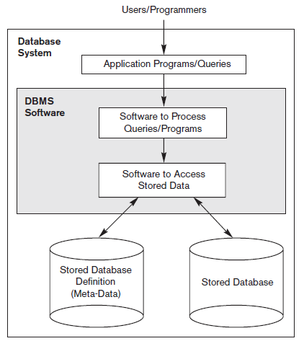
A simplified database system environment.
Notes:
An application program accesses the database by sending queries or requests for data to the DBMS.

Slide 7
Characteristics of the Database Approach
Self-describing nature of a database system
  definition is stored in the DBMS catalog, which contains information such as the structure of each file, the type and storage format of each data item, and various constraints on the data.
Insulation between programs and data, and data abstraction
  Program-data independence
Support of multiple views of the data
  A view may be a subset of the database or it may contain virtual data that is derived from the database files but is not explicitly stored.
Sharing of data and multiuser transaction processing
  ACID Properties

Slide 8
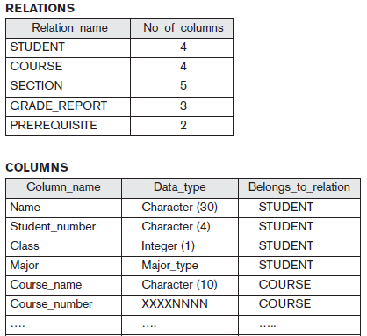

Slide 9
Database users:
Actors on the scene – actively involves day to day database activities
  Database Administrators
  Database Designers
  End Users
  System Analysts and Application Programmers (Software Engineers)
Actors behind the scene – maintain the database environment system
  DBMS system designers and implementers
  Tool developers
  Operators and maintenance personnel

Slide 10
Database Administrators
In a database environment, the primary resource is the database itself, and the secondary resource is the DBMS and related software. Administering these resources is the responsibility of the database administrator (DBA).
The DBA is responsible for authorizing access to the database, coordinating and monitoring its use, and acquiring software and hardware resources as needed.
The DBA is accountable for problems such as security breaches and poor system response time. In large organizations, the DBA is assisted by a staff that carries out these functions.
Notes:
In any organization where many people use the same resources, there is a need for a chief administrator to oversee and manage these resources.

Slide 11
Database Designers
Responsible for identifying the data to be stored in the database and for choosing appropriate structures to represent and store this data.
Database designers typically interact with each potential group of users and develop views of the database that meet the data and processing requirements of these groups.
Each view is then analysed and integrated with the views of other user groups. The final database design must be capable of supporting the requirements of all user groups.
Notes:
These tasks are mostly undertaken before the database is actually implemented and populated with data.
It is the responsibility of database designers to communicate with all prospective database users in order to understand their requirements and to create a design that meets these requirements.
In many cases, the designers are on the staff of the DBA and may be assigned other staff responsibilities after the database design is completed.

Slide 12
End Users
End users are the people whose jobs require access to the database for querying, updating, and generating reports.
Casual end users occasionally access the database, but they may need different information each time. They use a sophisticated database query language to specify their requests and are typically middle- or high-level managers.
Naive or parametric end users, their main job function revolves around constantly querying and updating the database, using standard types of queries and updates - called canned transactions - that have been carefully programmed and tested.
Sophisticated end users include engineers, scientists, business analysts, and others who thoroughly familiarize themselves with the facilities of the DBMS in order to implement their own applications to meet their complex requirements.
Standalone users maintain personal databases by using ready-made program packages that provide easy-to-use menu-based or graphics-based interfaces.
Notes:
the database primarily exists for their use.

Slide 13
System Analysts and Application Programmers
System analysts determine the requirements of end users, especially naive and parametric end users, and develop specifications for standard canned transactions that meet these requirements.
Application programmers implement these specifications as programs; then they test, debug, document, and maintain these canned transactions.
Such analysts and programmers—commonly referred to as software developers or software engineers—should be familiar with the full range of capabilities provided by the DBMS to accomplish their tasks.

Slide 14
Advantages of Using the DBMS Approach
Controlling Redundancy
Restricting Unauthorized Access
Providing Storage Structures and Search Techniques for Query Processing
Providing Backup and Recovery
Providing Multiple User Interfaces
Representing Complex Relationships among Data
Enforcing Integrity Constraints

Slide 15
When Not to Use a DBMS
High initial investment in hardware, software, and training
Overhead for providing security, concurrency control, recovery, and integrity functions
Simple, well-defined database applications that are not expected to change at all
Embedded systems with limited storage capacity, where a general-purpose DBMS would not fit
No multiple-user access to data

Slide 16
Database System Architecture
Architecture of DBMS packages has evolved
Client/server system architecture
The system functionality is distributed between two types of modules.
  Client module : designed to run on a user workstation or personal computer.
  Server module : handles data storage, access, search, and other functions.

Slide 17
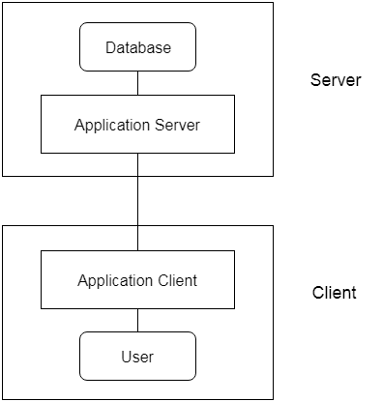

Slide 18
Data Models, Schemas, and Instances
Data abstraction : generally refers to the suppression of details of data organization and storage, and the highlighting of the essential features for an improved understanding of data.
Notes:
One of the main characteristics of the database approach is to support data abstraction so that different users can perceive data at their preferred level of detail.

Slide 19
Data model:
Collection of concepts that can be used to describe the structure of a database
Provides the necessary means to achieve data abstraction.
By structure of a database we mean the data types, relationships, and constraints that apply to the data.
Data model defines how the logical structure of a database is modelled. Data models show that how the data is connected and stored in the system. It shows the relationship between data.
Notes:
Most data models also include a set of basic operations

Slide 20
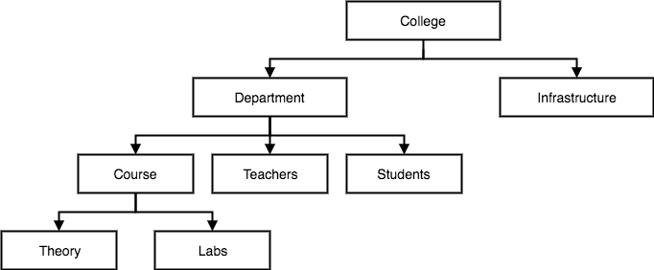

Slide 21
Categories of Data Models
High-level (conceptual data models)
Low-level (physical data models)
representational (implementation data models)

Slide 22
High-level (conceptual data models)
Provide concepts that are close to the way many users perceive data
Conceptual data models use concepts such as entities, attributes, and relationships.
An entity represents a real-world object or concept that is described in the database.
An attribute represents some property that describes an entity.
A relationship among two or more entities represents an association among the entities.
Notes:
Concepts provided by low-level data models are generally meant for computer specialists, not for end users.

Slide 23
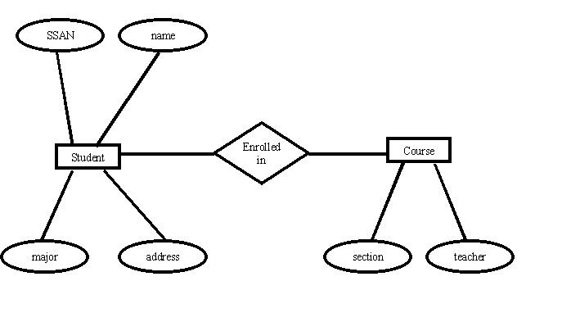
Entity Relationship Data Model
Entity and their attributes
Relationships among entities
Notes:
An entity has a real world property called attribute and attribute define by a set of values called domain. For example, in a university a student is an entity, university is the database, name and age and sex are the attributes. The relationships among entities define the logical association between entities.

Slide 24
Low-level (physical data models)
Provide concepts that describe the details of how data is stored on the computer storage media
Concepts provided by low-level data models are generally meant for computer specialists, not for end users.

Slide 25
representational data models
Between these two extremes is a class of representational (implementation) data models, which provide concepts that may be easily understood by end users and hide many details of data storage on disk.
Implementation data models are the models used most frequently in traditional commercial DBMSs.
These include the widely used relational data model, the network model and hierarchical models.

Slide 26
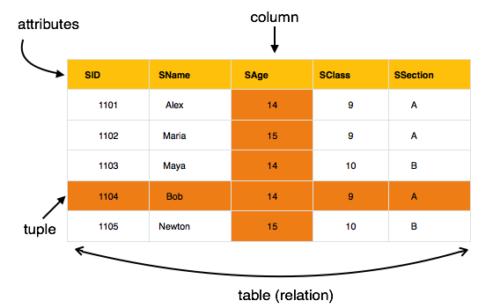
Relational Data Model
The data is stored in the tables
Relations can be normalized.
In normalized relations, values saved are atomic values.
Each row in a relation contains a unique value.
Each column in a relation contains values from a same domain.

Slide 27
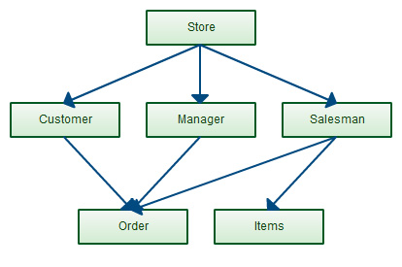
Network Data Model
Network model has the entities which are organized in a graphical representation and some entities in the graph can be accessed through several paths.

Slide 28
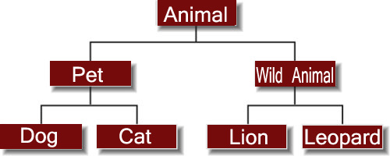
Hierarchical Data Model
Hierarchical model has one parent entity with several children entity
At the top we should have only one entity called root.
Notes:
For example, department is the parent entity called root and it has several children entities like students, professors and many more.

Slide 29
Database Schemas
In any data model, it is important to distinguish between the description of the database and the database itself.
The description of a database is called the database schema
A displayed schema is called a schema diagram i.e. structural view(design) of a database.

Slide 30
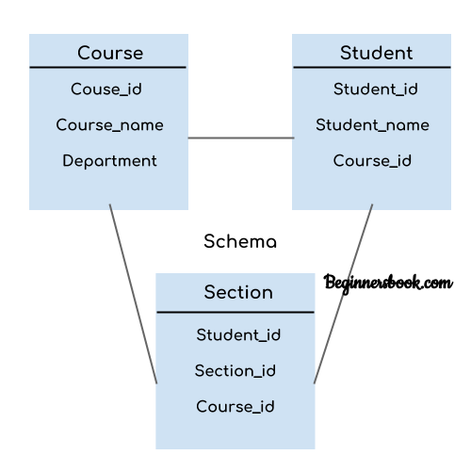

Slide 31
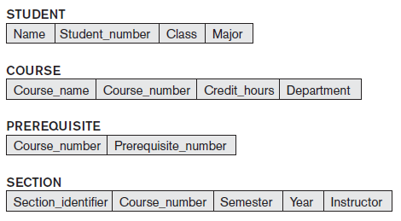
A schema diagram displays only some aspects of a schema

Slide 32
Database state
The actual data in a database may change quite frequently.
The data in the database at a particular moment in time is called a database state or instance in the database.
Database schema defines the variable declarations in tables that belong to a particular database; the value of these variables at a moment of time is called the instance of that database.

Slide 33
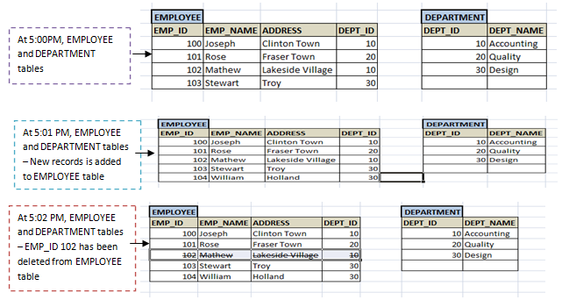

Slide 34
Empty state : When we define a new database, we specify its database schema with no data.
Initial state : when the database is first loaded with the initial data.
Current state : At any point in time, the database has a current state
Valid state : state that satisfies the structure and constraints specified in the schema

